Slide 1
Supply and Demand Gap Analysis
Uber Request Data

Slide 2
Abstract
The analysis shows the supply & demand gaps of uber over the customer service with the available data set.
The Root Causes (estimated) are estimated based on the inputs available.
The Data containing Trip details, Driver ID, Pickup locations, Time & Date are used so as to get to the estimation.

Slide 3
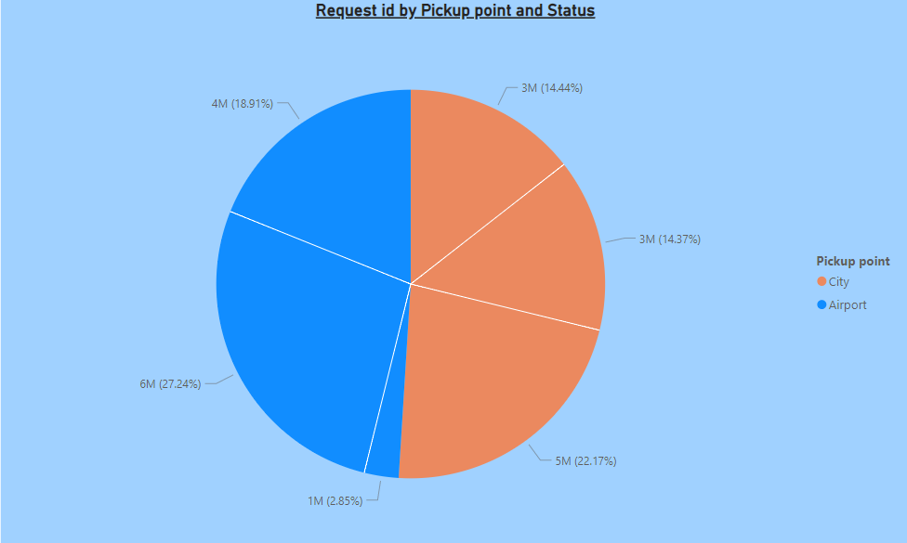
The pie chart depicts the pickup points and the Status of the trip with respect to the driver’s ID.
The major share is that of No cars available 27% of total, which shows the area of concern or the field that is to be worked upon.
Also the trips of the City : Airport ratio is very less. More trips to be extended in rural & airport areas too.

Slide 4
Insights/Key highlights
The total number of Drivers & their activity of trips represents the performance of the company.
The number of cars available in particular region is more with regards to the dataset which is why the performance is declined over the year(2016).
The Cancellation ratio in the Airports to that of the City(2% : 14%) is way better which should also be continued into the Cities as well.

Slide 5
Recommendations
The amount of trips into rural areas should be increased.
Cancellation ratio in cities should be decreased as a result of increased trips.
Increasing in the Driver trip price- company share should be re-examined.

Slide 6
Conclusion
The Demand & Supply Ratio is satisfactory with proper measures, however the gaps can be filled in for the overall growth of the company.

